Slide 1



Why do they call it a “Support Vector Machine”? What is being “supported” and where is the “machine”?
$$\min_{w∈ℝ^{d}}{\frac{1}{2}{\left\|w\right\|}_{2}^{2}}+C\sum_{i=1}^{n}{{\left[1−y^{i}⋅w^{⊤}x^{i}\right]}_{+}}$$
Primal
$$\min_{0≤α≤C⋅1}{\frac{1}{2}\sum_{i∈\left[n\right]}{\sum_{j∈\left[n\right]}{α_{i}α_{j}y^{i}y^{j}\left\langle x^{i},x^{j}\right\rangle }}−α^{⊤}1}$$
Dual

Slide 2
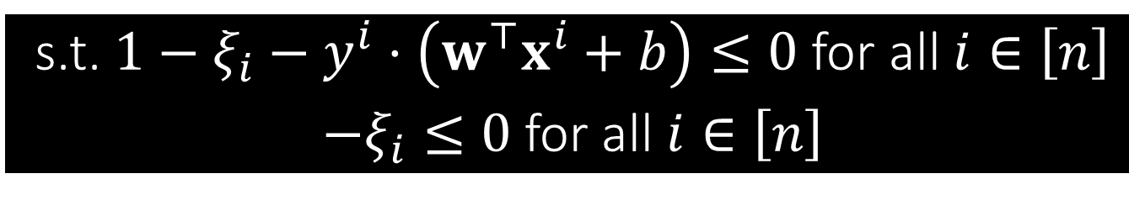



CSVM with an explicit bias
As per our convention, we rewrite $≥$ constraints as $≤$ constraints
$$\min_{w,b,ξ }{\frac{1}{2}{\left\|w\right\|}_{2}^{2}}+C\sum_{i=1}^{n}{ξ_{i}}$$
s.t. $y^{i}⋅\left(w^{⊤}x^{i}+b\right)≥1−ξ_{i}$ for all $i∈\left[n\right]$
$ξ_{i}≥0$ for all $i∈\left[n\right]$
Step 0: Already a minimization problem – nothing to do!
Step 1: Introduce dual variables $α_{i}≥0,i∈\left[n\right]$ and $β_{i}≥0,i∈\left[n\right]$
Step 2: Create the Lagrangian $ℒ\left(w,b,ξ,α,β\right)=$ $\frac{1}{2}{\left\|w\right\|}_{2}^{2}−\sum_{i=1}^{n}{α_{i}y^{i}⋅\left(w^{⊤}x^{i}+b\right)}+ξ^{⊤}\left(C⋅1−α−β\right)+α^{⊤}1$
s.t. $1−ξ_{i}−y^{i}⋅\left(w^{⊤}x^{i}+b\right)≤0$ for all $i∈\left[n\right]$
$−ξ_{i}≤0$ for all $i∈\left[n\right]$
Recall that we always hide the bias term inside the model as $\left[w,b\right]$? We need to stop doing that for today’s discussion

Slide 3


CSVM with an explicit bias
Gives us a way to recover the optimal value of $w$ once we have solved the dual problem and obtained the optimal value of $α$
$$\frac{1}{2}{\left\|w\right\|}_{2}^{2}−\sum_{i=1}^{n}{α_{i}y^{i}⋅\left(w^{⊤}x^{i}+b\right)}+ξ^{⊤}\left(C⋅1−α−β\right)+α^{⊤}1$$
Step 5: Simplify the dual $q\left(α,β\right)=\min_{w,b,ξ}{ℒ\left(w,b,ξ,α,β\right)}$
To minimize w.r.t $w$, apply FOO to get $\frac{∂ℒ}{∂w}=0⇒w=\sum_{i=1}^{n}{α_{i}y^{i}⋅x^{i}}$
To minimize w.r.t $b$, notice that the Lagrangian is linear in $b$. Thus, if $\sum_{i=1}^{n}{α_{i}y^{i}}≠0$, we would have $q\left(α,β\right)=−∞$
Since we wish to maximize $q\left(⋅\right)$, we must have $\sum_{i=1}^{n}{α_{i}y^{i}}=0$ at optimum
To minimize w.r.t. $ξ$, note that if $C⋅1−α−β≠0$, we get $q\left(α,β\right)=−∞$
Since we wish to maximize $q\left(⋅\right)$, we must have $α+β=C⋅1$ at optimum

Slide 4
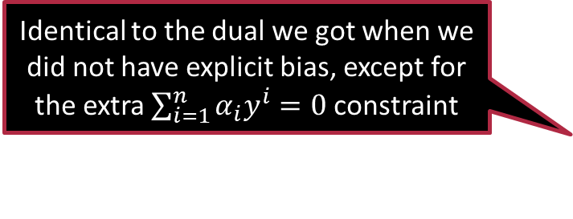

CSVM with an explicit bias
Identical to the dual we got when we did not have explicit bias, except for the extra $\sum_{i=1}^{n}{α_{i}y^{i}}=0$ constraint
$$\min_{w,b,ξ}{\frac{1}{2}{\left\|w\right\|}_{2}^{2}}+C\sum_{i=1}^{n}{ξ_{i}}$$
s.t. $1−ξ_{i}−y^{i}⋅\left(w^{⊤}x^{i}+b\right)≤0$ for all $i∈\left[n\right]$
$−ξ_{i}≤0$ for all $i∈\left[n\right]$
Step 5: Simplify the dual continued
Eliminating $β$ (and its constraints) and some rearrangements later, we get
$$\min_{α}{\frac{1}{2}\sum_{i∈\left[n\right]}{\sum_{j∈\left[n\right]}{α_{i}α_{j}y^{i}y^{j}\left\langle x^{i},x^{j}\right\rangle }}−α^{⊤}1} \\ \text{s}\text{.}\text{t}\text{. }α_{i}∈\left[0,C\right]$$
$$\sum_{i=1}^{n}{α_{i}y^{i}}=0$$

Slide 5




What’s in a name?
Because they are unhappy that the decision boundary separated them from their friends of the other class
Let us consider $d=3$ for simplicity
Suppose we have solved the SVM problem to get optimal model $w^{∗}$, bias $b^{∗}$, slacks $ξ_{i}^{∗}$, dual variables $α_{i}^{∗}$
Sep. hyperplane ${\left(w^{∗}\right)}^{⊤}x+b=0$
Let $u≝{w^{∗}}/{{\left\|w^{∗}\right\|}_{2}}$ be the unit vector along the vector $w^{∗}$
Imagine that each point $x^{i}$ is exerting a force $y^{i}α_{i}^{∗}⋅u$ on the separating hyperplane ${\left(w^{∗}\right)}^{⊤}x+b=0$
Why on earth would data points push on the hyperplane?
Data points with $α_{i}^{∗}→0$ will hardly push at all while those with $α_{i}^{∗}→C$ will push very strongly
The things you make us do Melbo!

Slide 6








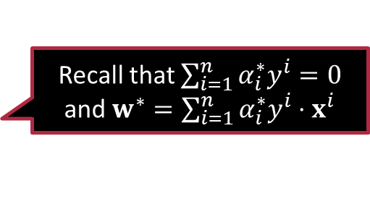

What’s in a name?
The torque due to force $F$ at point $r$ is $r⊗F$ where $⊗$ denotes the cross product. The cross product of two parallel vectors is zero.
Recall that $\sum_{i=1}^{n}{α_{i}^{∗}y^{i}}=0$
and $w^{∗}=\sum_{i=1}^{n}{α_{i}^{∗}y^{i}⋅x^{i}}$
$$F$$
$$τ=r⊗F$$
$$r$$
Each point $x^{i}$ is exerting a force $y^{i}α_{i}^{∗}⋅u$ on the separating hyperplane
Total force turns out to be zero! $\sum_{i∈\left[n\right]}{y^{i}α_{i}^{∗}⋅u}=0$
Total torque turns out to be zero! $\sum_{i∈\left[n\right]}{x^{i}⊗\left(y^{i}α_{i}^{∗}⋅u\right)}=\sum_{i∈\left[n\right]}{\left(α_{i}^{∗}y^{i}⋅x^{i}\right)⊗u}=w^{∗}⊗u=0$
Thus, points with $α_{i}^{∗}≠0$ are “supporting” the hyperplane!
Data points with $α_{i}^{∗}≠0$ are called support vectors
Note: $w^{∗}$ is defined in terms of support vectors alone.
Non-support vectors i.e., those with $α_{i}^{∗}=0$ do not contribute to $w^{∗}$.
Computational units are often called machines hence the name SVM ☺

Slide 7

Exercise
To learn more about SVMs and their history, check out this wonderful tutorial
Chris Burges, A Tutorial on Support Vector Machines for Pattern Recognition, Data Mining and Knowledge Discovery 2, 121-167, 1998.
Derive the dual for the “hard SVM” that doesn’t have slack terms
$$\min_{w,b}{\frac{1}{2}{\left\|w\right\|}_{2}^{2}}$$
s.t. $y^{i}⋅w^{⊤}x^{i}≥1$ for all $i∈\left[n\right]$
What differences do you notice with the dual for the C-SVM problem?
What happens to the dual if you have an explicit bias term?
$$\min_{w,b}{\frac{1}{2}{\left\|w\right\|}_{2}^{2}}$$
s.t. $y^{i}⋅\left(w^{⊤}x^{i}+b\right)≥1$ for all $i∈\left[n\right]$

Slide 8
Have a nice day ahead!
Chat with you next time.

